Slide 1

JSON WEB TOKEN(JWT) Lecture 19
BY:
Muhammad Rashid Mukhtar

Slide 2
CONTENTS
Introduction
Cookie Based
Token Based
JSON Web Token
When to use JWT?
JWT Structure
How JWT works?
JWT v/s other methods
Cons
Server Side Application without Passport
Server Side Application with Passport

Slide 3
INTRODUCTION
Authentication
Ways to validate
(i). Cookie based (Stateful)
(ii). Token based (Stateless)

Slide 4
Cookie Based
Stateful : An authentication record or session must be maintained. The server needs to keep track of active sessions in a database.
Every request is accompanied by a cookie.
Whenever the user makes a request, the server validates the cookie and session Id.
Basic flow using cookie authentication:

Slide 5
Token Based
Stateless: The server does not keep a record of which users are logged in . Instead, every request to the server is accompanied by a token which the server uses to verify the authenticity of the request.
Basic Flow of token based authentication:

Slide 6
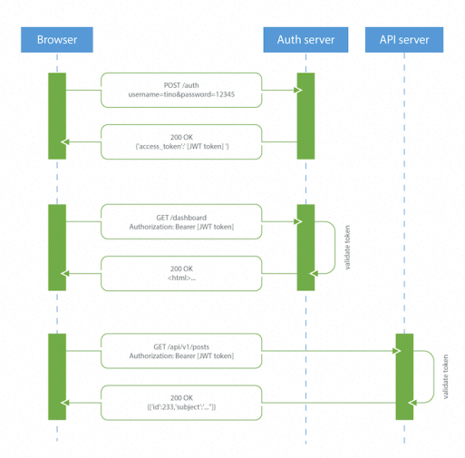

Slide 7
Why Token-Based Authentication?
Session authentication becomes a problem when we need stateless servers and scalability
Mobile application platforms have a hard time handling cookies/sessions
Sharing authentication with other applications not feasible
Cross-origin resource sharing (CORS) problem
Cross-site request forgery (CSRF)
Hence, Token based authentication is better than Cookie based authentication.

Slide 8
JSON Web Tokens
JSON Web Token (JWT) is a compact, open standard means of representing claims to be transferred between two parties. These are encoded as a JSON object that is used as the payload of a JSON Web Signature (JWS) structure or as the plain text of a JSON Web Encryption (JWE) structure, enabling the claims to be digitally signed.
In layman’s language, JSON Web Token(JWT) is a self-verified encoded string that is used in Modern Web/Mobile app for both Authentication and Authorization. The fact that it is stateless removes the maintenance efforts that we need for other Authentication and Authorization tools. It is used as a replacement to cookies, or rather improvement over cookies.
Compact and Self Contained.
Used by Node.js, Ruby, python etc.

Slide 9
When to use JWT?
Authentication : Once the user is logged in, each subsequent request will include the JWT, allowing the user to access routes, services, and resources that are permitted with that token. It’s a feature that widely because of its small overhead and its ability to be easily used across different domains.
Information Exchange: JSON Web Tokens are a good way of securely transmitting information between parties, because as they can be signed, for example using public/private key pairs, you can be sure that the senders are who they say they are. You can also verify that the content hasn't been tampered. (using header and payload)

Slide 10
JWT v/s Other Token Methods
Better than Simple Web Token(SWT) and SAML(Simple Assertion Markup Language).
Security
Common parser
Notes:
jwt.io samltool.io

Slide 11

JWT Structure
JWT Tokens consists of three parts appended by a (dot).
Header: type of token, hash algorithm
Payload: claims (public, private and reserved)
Signature

Slide 12
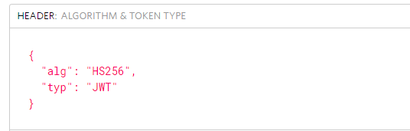
HEADER

Slide 13
PAYLOAD
Common claims are:
Issuer (iss)
Subject (sub)
Audience (aud)
Expiration time (exp)
Not before (nbf)
Issued at (iat)
JWT ID (jti)

Slide 14
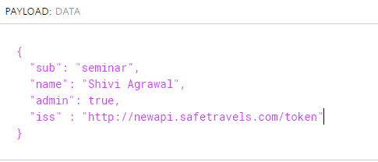

Slide 15
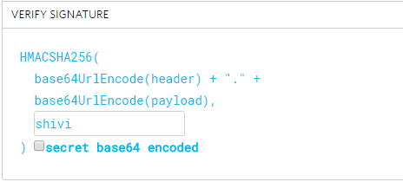
SIGNATURE

Slide 16
JWT

Slide 17
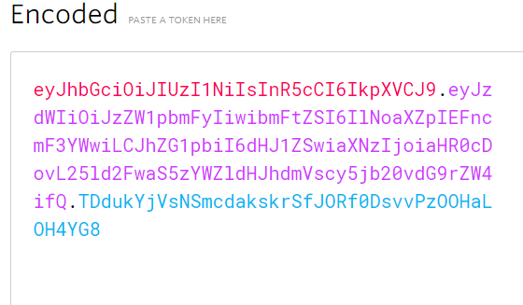
OUTPUT (JWT)

Slide 18
Simple Mechanism
In JWT, a token is encoded from a data payload using a secret.
That token is passed to the client.
Whenever the client sends that token along with a request, the server validates it and sends back the response.

Slide 19
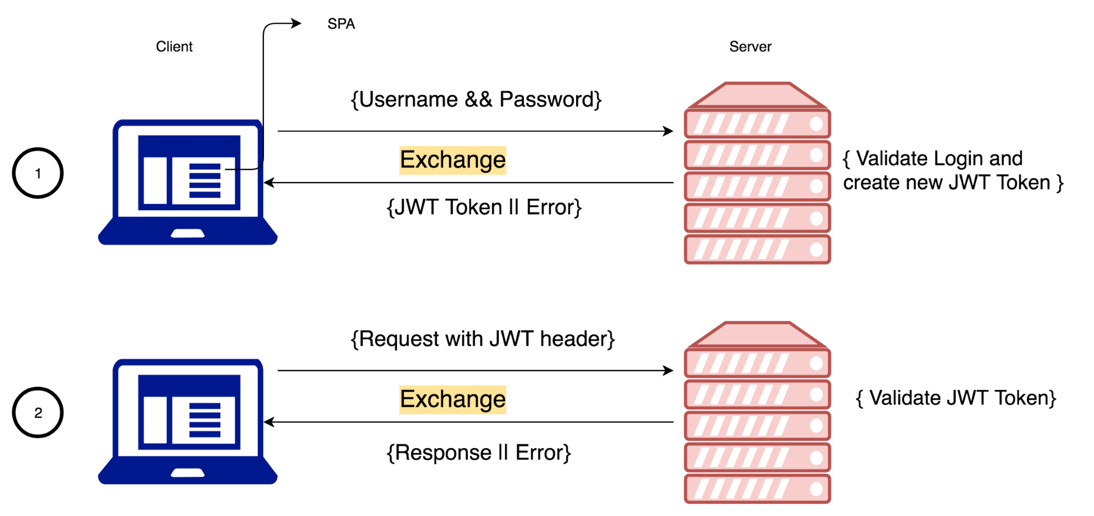
JWT Mechanism

Slide 20
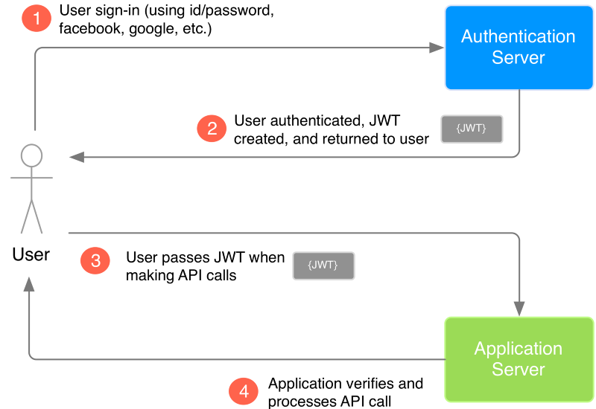
How JWT works?

Slide 21
Whenever the user wants to access a protected route, it should send the JWT, typically in the Authorization header using the Bearer schema.
The content of the header should look like the following: Authorisation: Bearer<Token>

Slide 22
Cons of JWT
Data Overhead.
Security of whole platform will be compromised if the secret key is leaked.

Slide 23
jsonwebtoken
module

Slide 24
jsonwebtoken
There are many libraries available in different languages developed already.
You plug them, and you get two main functionalities to generating JWT, validate JWT, etc.
Here we pick an NPM library called jsonwebtoken which is suggested by the JWT website.
Install it globally or for specific project
Npm install jsonwebtoken –g//for global

Slide 25
Provides several methods:
– sign() for signing and issuing token
– verify() for verifying and decoding token and making it
available on the request property in Express

Slide 26
Server Side Sample Application Without Passport
We need to create two files other than app.js in our application at same level.
Config.js
Middleware.js
In config.js, we just define the secret which is master password.
This secret will be read by JWT library while creating and validating tokens.
In production, we need to store this secret in environment variable instead of a file.
module.exports = {
secret: ‘bcs7sp20’
};

Slide 27
Middleware.js
let jwt = require('jsonwebtoken');
const config = require('./config.js');
let checkToken = (req, res, next) => {
let token = req.headers['x-access-token'] || req.headers['authorization’];
// Express headers are auto converted to lowercase
if (token.startsWith('Bearer ')) {
// Remove Bearer from string
token = token.slice(7, token.length);
}
if (token) {
jwt.verify(token, config.secret, (err, decoded) => {
if (err) {
return res.json({
success: false,
message: 'Token is not valid'
});
}
else {
req.decoded = decoded;
next();
}
});
} else {
return res.json({
success: false,
message: 'Auth token is not supplied'
});
}
};
module.exports = {
checkToken: checkToken
}

Slide 28
Middleware.js
In the middleware.js, we can write a function that acts as middleware to get a token from a request and proceeds only when the token is validated.
In Last Code
Capture headers with names ‘x-access-token’ or ‘Authorization.’
If the header is in ‘Authorization: Bearer xxxx…’ format, strip unwanted prefix before token.
Using jwt package and secret string, validate the token.
If anything goes wrong, return an error immediately before passing control to next handler.
Export the middleware function for other modules to use.
At this moment, we haven’t written any code to create a token. We will do that next.

Slide 29
app.js
let jwt = require('jsonwebtoken');
let config = require('./config');
let middleware = require('./middleware');
class HandlerGenerator {
login (req, res) {
let username = req.body.username;
let password = req.body.password;
if (username && password) {
if (username === admin && password === ‘admin’) {
let token = jwt.sign({username: username},
config.secret,
{ expiresIn: '24h’
// expires in 24 hours
} );
// return the JWT token for the future API calls
res.json({
success: true,
message: 'Authentication successful!',
token: token
});
}
else {
res.send(403).json({
success: false,
message: 'Incorrect username or password'
});
} }
else {
res.send(400).json({
success: false,
message: 'Authentication failed! Please check the request'
});
} }

Slide 30
App.js
index (req, res) {
res.json({ success: true, message: 'Index page'
}); }}
let handlers = new HandlerGenerator();
// Routes & Handlers
app.post('/login', handlers.login);//login request by client
app.get('/', middleware.checkToken, handlers.index);//get info after checking
app.listen(3000, () => console.log(`Server is listening on port: 3000`));
}

Slide 31
Implementing JWT
With Passport and Mongoose-local

Slide 32
JWT with Passport
Passport-JWT
Passport strategy for authenticating using JWT
Authenticate RESTful endpoints using JWT without needing sessions
Installing:
npm install passport-jwt –save
Create and configure a new Passport strategy based on JWT authentication
Extracting the JWT from an incoming request
Header, body, URL Query parameter, . .

Slide 33
User Schema
var mongoose = require('mongoose');
var Schema = mongoose.Schema;
var passportLocalMongoose = require('passport-local-mongoose');
var User = new Schema({
firstname: {
type: String,
default: ''
},
lastname: {
type: String,
default: ''
},
admin: {
type: Boolean,
default: false
}
});
User.plugin(passportLocalMongoose);
module.exports = mongoose.model('User', User);

Slide 34
Authentication Strategy
var passport = require('passport');
var LocalStrategy = require('passport-local').Strategy;
var User = require('./models/user');
var JwtStrategy = require('passport-jwt').Strategy;
var ExtractJwt = require('passport-jwt').ExtractJwt;
var jwt = require('jsonwebtoken'); // used to create, sign, and verify tokens
var config = require('./config.js');
passport.use(new LocalStrategy(User.authenticate()));
passport.serializeUser(User.serializeUser());
passport.deserializeUser(User.deserializeUser());
exports.getToken = function(user) {
return jwt.sign(user, config.secretKey, { expiresIn: 3600 });
};

Slide 35
VerifyUser
var opts = {};
opts.jwtFromRequest = ExtractJwt.fromAuthHeaderAsBearerToken();
opts.secretOrKey = config.secretKey;
exports.jwtPassport = passport.use(new JwtStrategy(opts,
(jwt_payload, done) => {
console.log("JWT payload: ", jwt_payload);
User.findOne({ _id: jwt_payload._id }, (err, user) => {
if (err) {
return done(err, false);
} else if (user) {
return done(null, user);
} else {
return done(null, false);
}
});
})); exports.verifyUser = passport.authenticate('jwt', { session: false });

Slide 36
Signup/ Local Policy
router.post('/signup', (req, res, next) => {
User.register(new User({ username: req.body.username }),
req.body.password, (err, user) => {
if (err) {
//Response Error
} else {
if (req.body.firstname)
user.firstname = req.body.firstname;
if (req.body.lastname)
user.lastname = req.body.lastname;
user.save((err, user) => {
if (err) {
//end Error }
passport.authenticate('local')(req, res, () => {
res.statusCode = 200;
res.setHeader('Content-Type', 'application/json');
res.json({ success: true, status: 'Registration Successful!' });
});
});
}
});
});

Slide 37
Signin/Local+JWT
router.post('/login', passport.authenticate('local'), (req, res) => {
var token = authenticate.getToken({ _id: req.user._id });
res.statusCode = 200;
res.setHeader('Content-Type', 'application/json');
res.json({ success: true, token: token, status: 'You are successfully logged in!' });
});

Slide 38
Calling Authentication
var authenticate = require('../authenticate');
.post(authenticate.verifyUser, (req, res, next) => {
});

